Slide 1
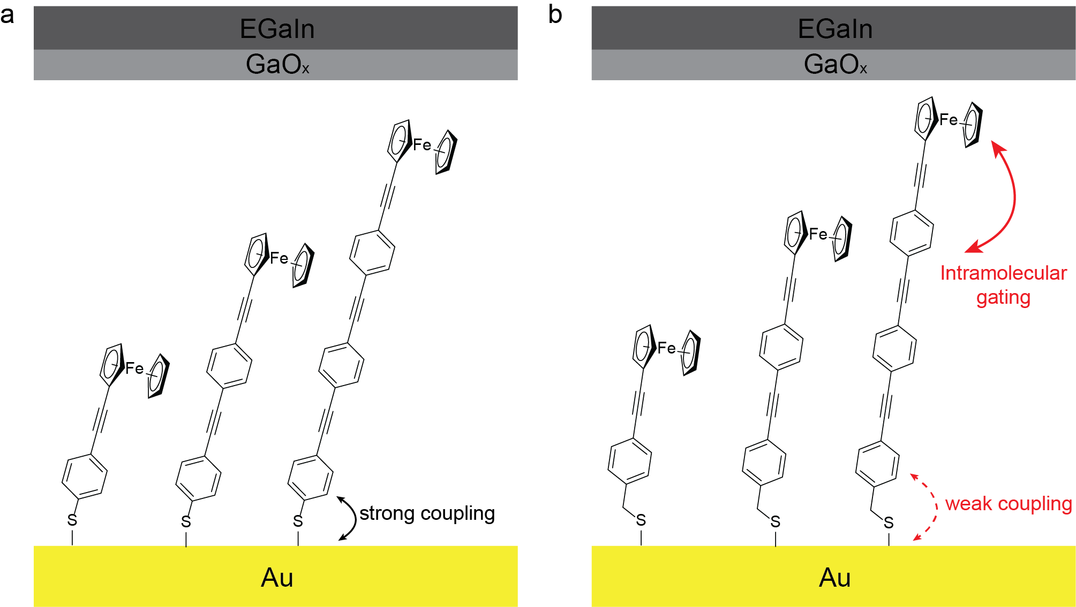
OPE3
OPE3C
OPE2
OPE2C
OPE1
OPE1C

Slide 2
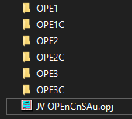
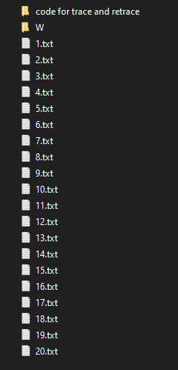
Data structure:
JV on cone-tip EGaIn folder:
All the txt files are the raw JV data, each one representing around 20 traces on one junction.
The average JV curves can be found in file
JV OPEnCnSAu.opj.

Slide 3
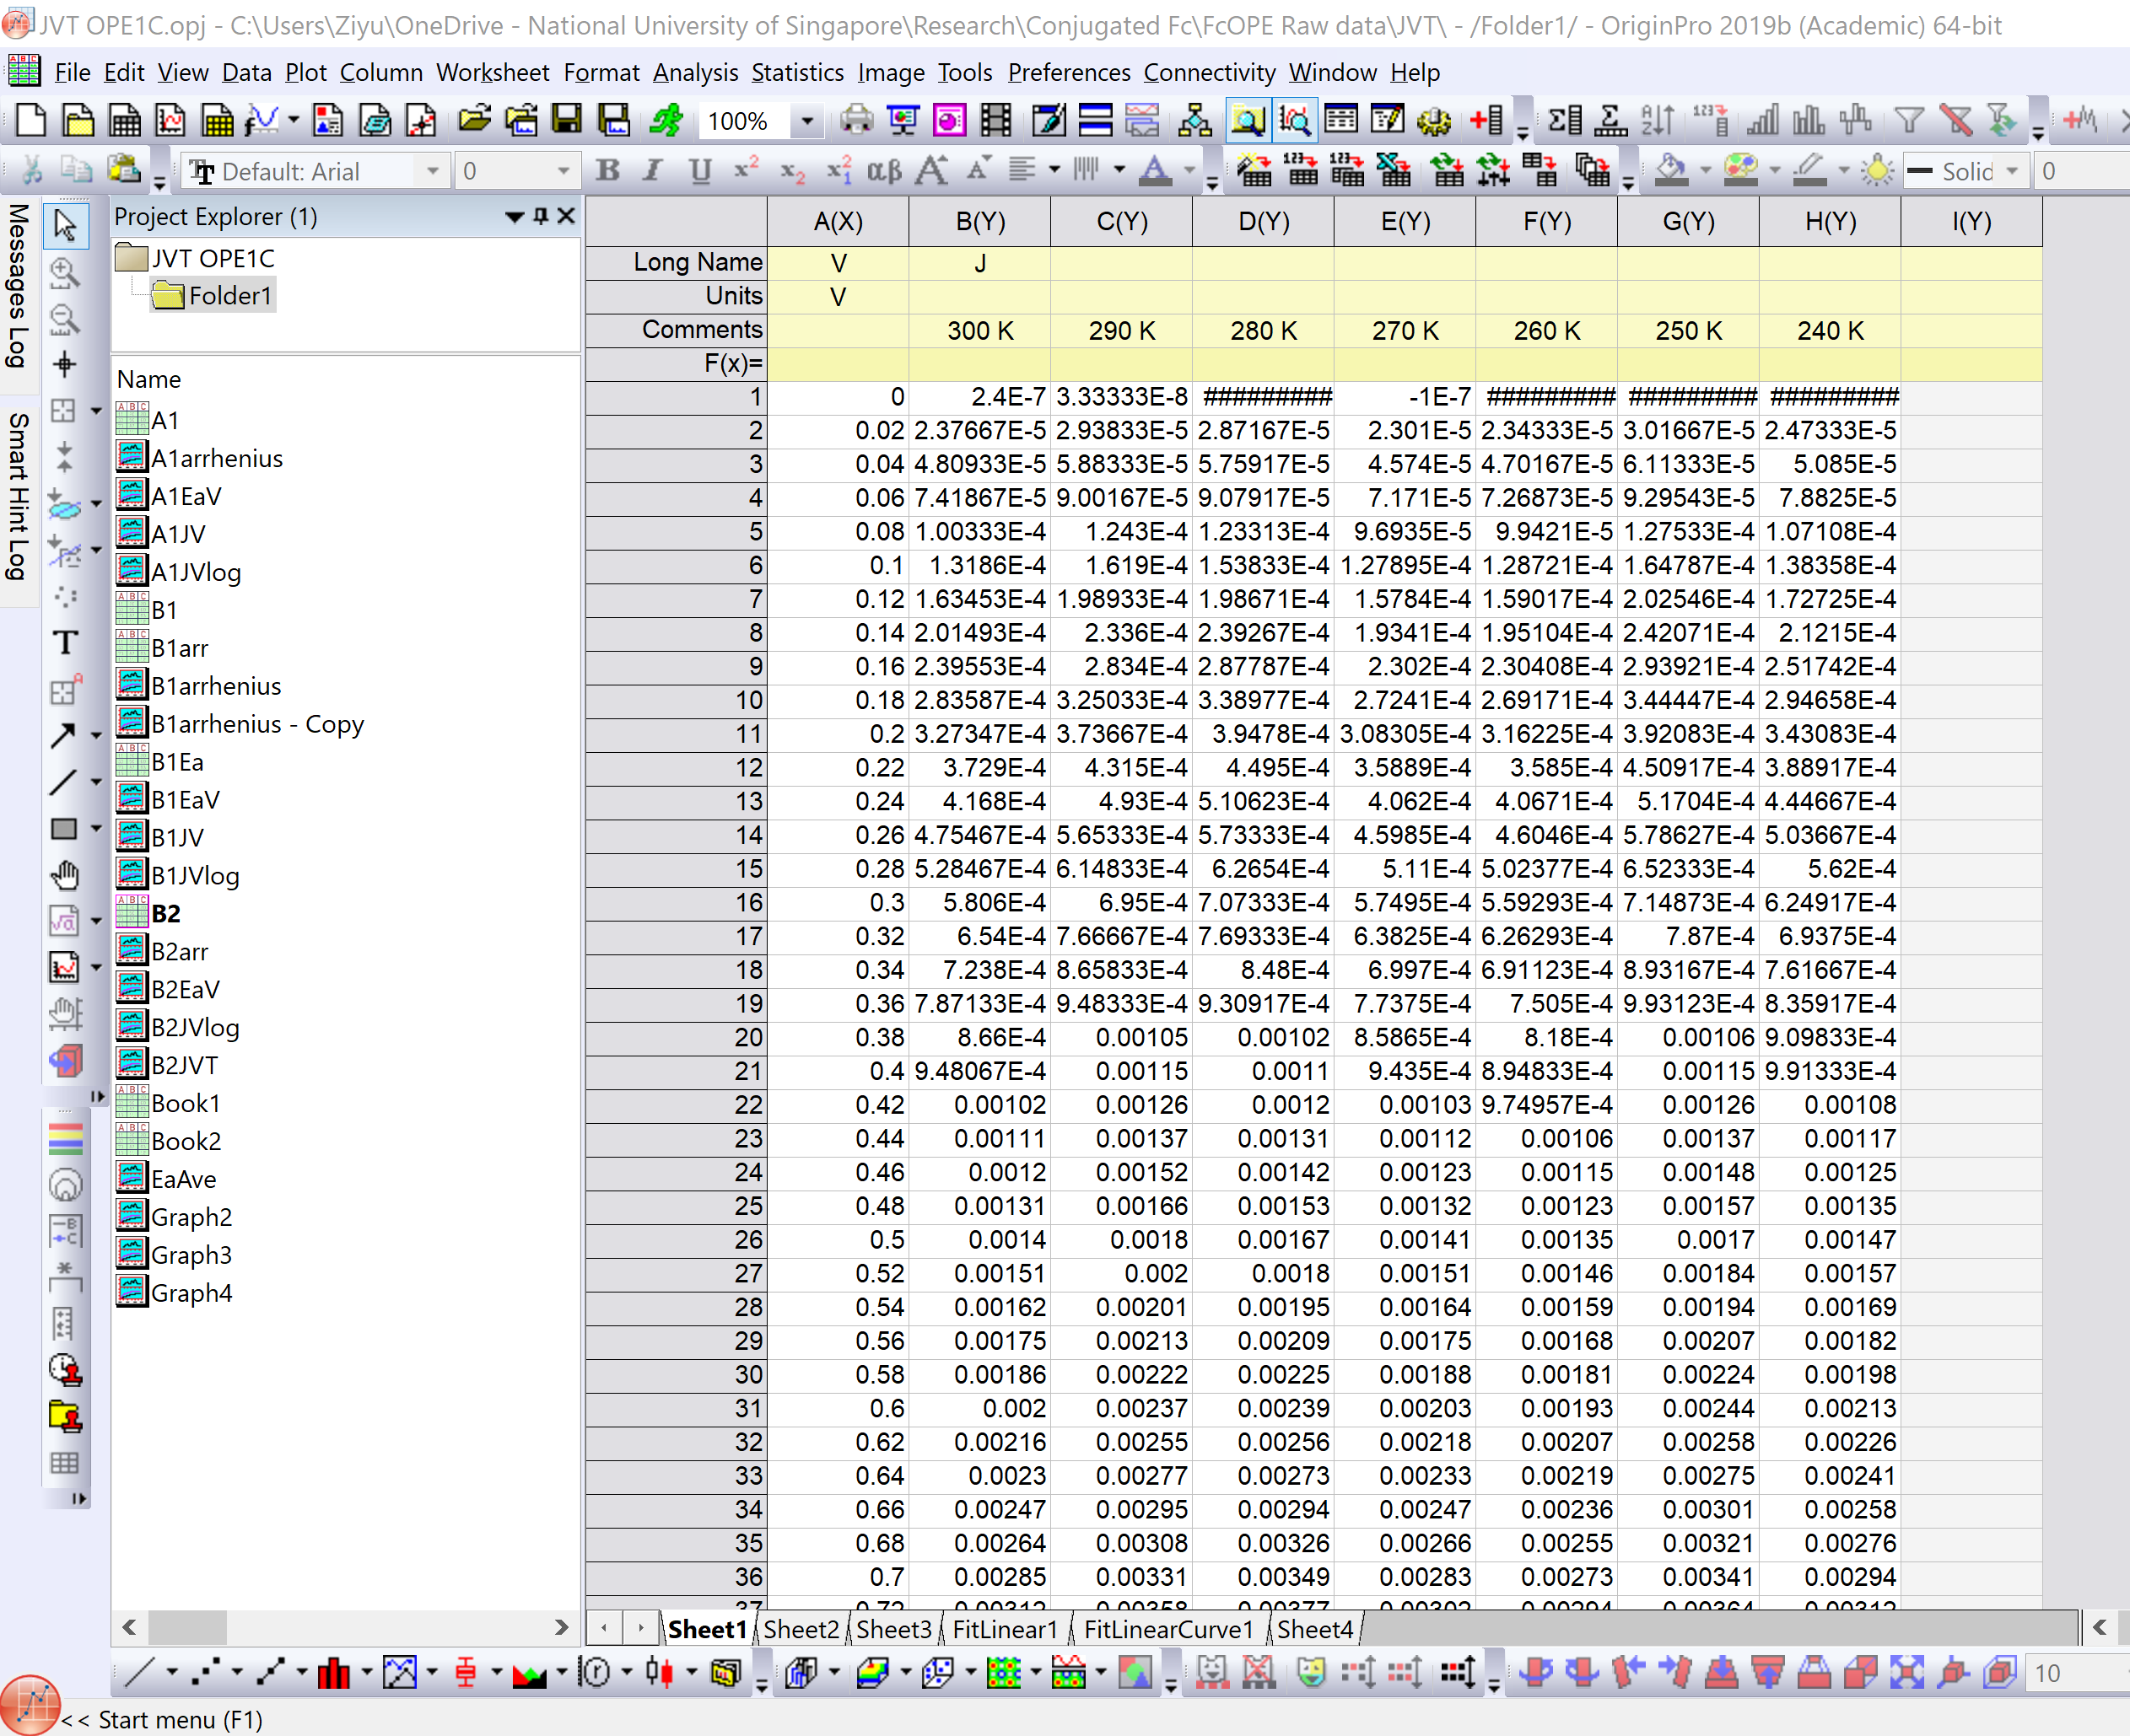
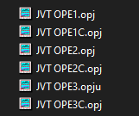
JVT folder:
You can find all raw data in the opj files. Please refer to the guide here. The unit of current density is always A/cm².
3 junctions
Sheet1 contains the JV data for each temperature

